Slide 1
Practice 2
Microsoft Power point

Slide 2
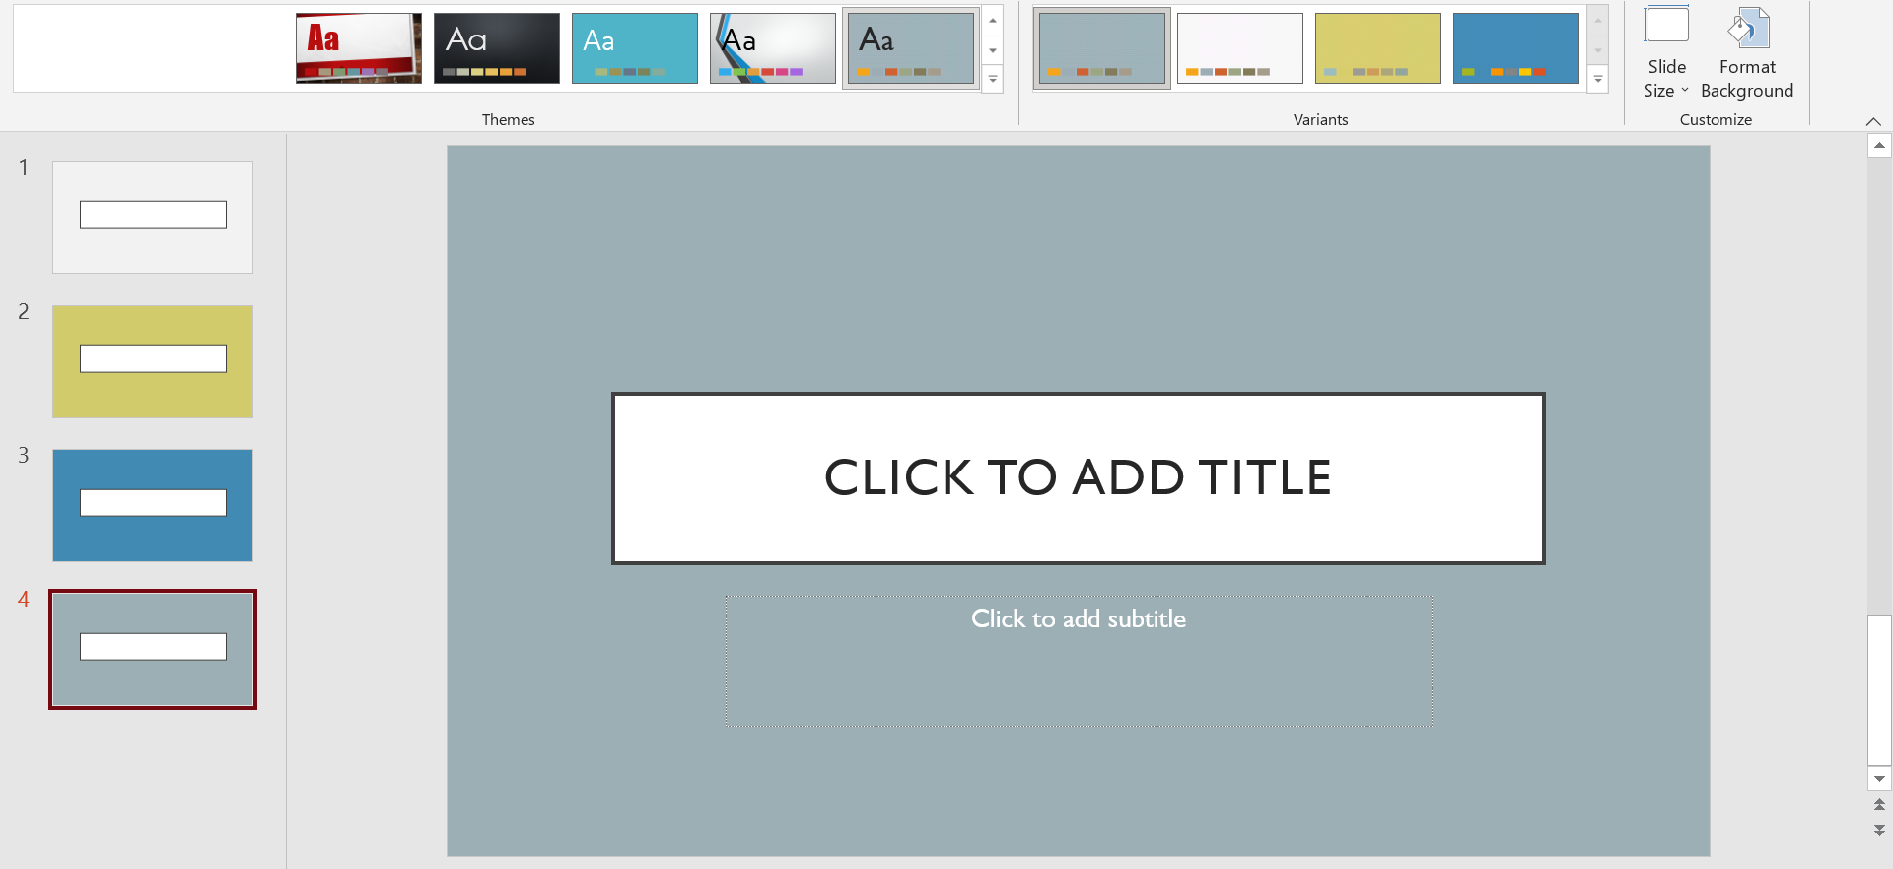
Create 5 slides and selected a theme for them and use variant to change the each themes
Practice Part
4
1
2
3

Slide 3

Practice

Slide 4
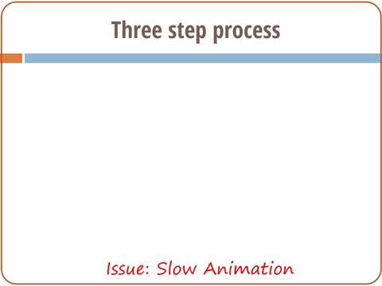
Practice

Slide 5
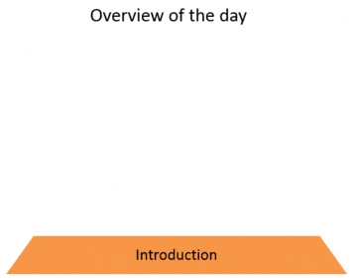
Practice

Slide 6





Questions
www.passerellesnumeriques.org

